Slide 1
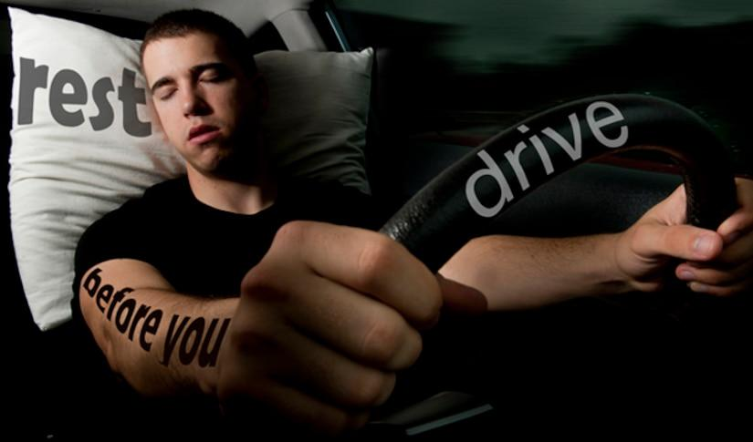
Drowsiness Detection System

Slide 2
What is Drowsiness Detection System ??
A computer vision system that can automatically detect driver drowsiness in a real-time video stream and then play an alarm if the driver appears to be drowsy.

Slide 3
Continue….
. Driver’s drowsiness is one of the main reasons for road accidents which lead to several fatalities every year.
. Statistics highlights the necessity of a drowsiness detection system that could possibly alert the co-passengers and driver before an accident would occur

Slide 4
Objectives of our project
. The main objective is to first design a system to detect driver’s drowsiness by continuously monitoring retina of the eye.
. The system works in spite of driver wearing spectacles and in various lighting conditions
. Speed of the vehicle can be reduced.

Slide 5
Continue…..
. To alert the driver on the detection of drowsiness by using buzzer or alarm
. Driver drowsiness detection is a car safety technology which helps to save the life of the driver by preventing accidents when the driver is getting drowsy.
. Traffic management can be maintained by reducing the accidents.

Slide 6
How do we know you are sleepy??
The Naive Analysis of Sleepiness:-
. Imagine your friend’s or loved one’s sleepy face, how did you know they were sleepy? Well,
the most obvious signs are:
1. Eyes : eyes are open (awake), eyes are closed (sleepy)
2. Mouth : Mouth is closing (awake), mouth is split/droopy (sleepy)
3. Head Position : Head is at the same position(awake), head is bobbing
(sleepy)

Slide 7
The Computer Vision Analysis
Eyes
Ratio of black pixels to white pixels (BW): to detect whether your eyes are open or closed. Because of your dark pupil, the larger your eyes open, the more black pixels would appear.
However, the problem is, there might be other confound variables which would interrupt the BW ratio:
Camera to user distance: users might be far away from the camera depending on their optimum study position. Obviously the further away they are, the less is the BW ratio and vice versa.
Eyes and pupil size: Eye size for different races might be different. Caucasians and Latinos will have different eye size.

Slide 8
Continue...
Mouth
Objects Detection and Labelling: to detect if the mouths are split or not. If the mouth is closing then there would be one connected lips. However, if the mouth is split, then your lips are not connected and will return multiple objects/lips detected.
Head Position
Face Detection with Accelerometer: to graph the movement of the face. The more your face moves vertically, the more likely you are sleepy.

Slide 9
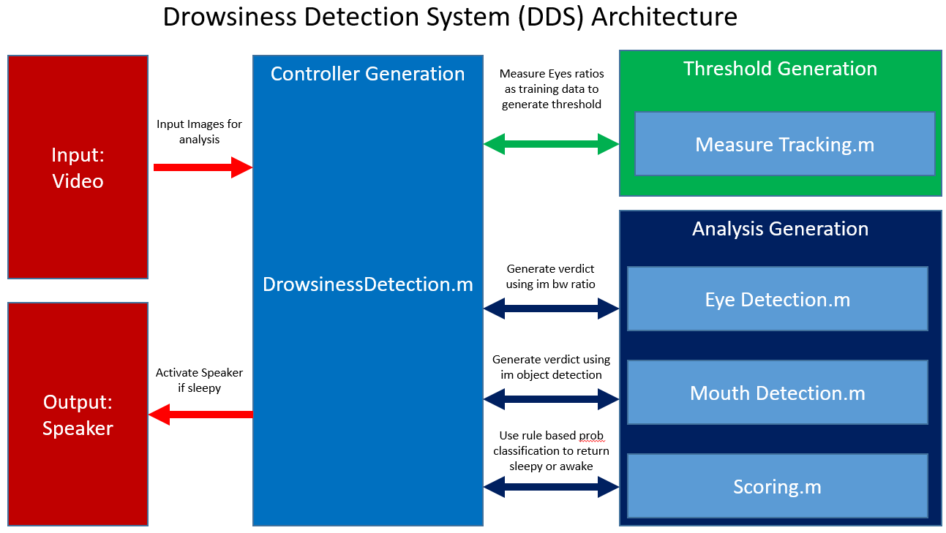

Slide 10
The Technical Architecture of our Application
DrowsinessDetection.m: Capture a live camera tracking and run classifier methods for each VideoFrame taken.
EyeDetection.m : Capture and crop eyes for each VideoFrame and run classification variable (ratios).
MouthDetection.m : Capture and crop mouth for each VideoFrame and run classification variable (lips detected).

Slide 11
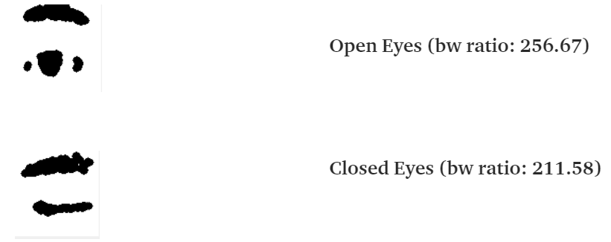
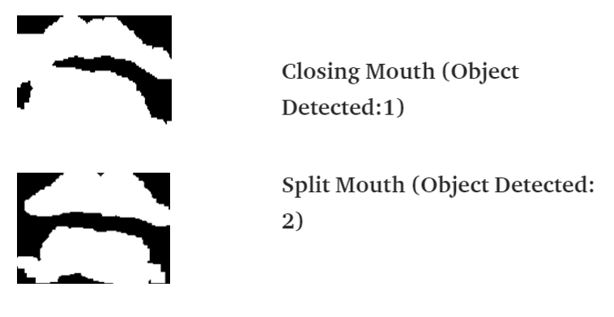
Ratio of Black Pixel to White Pixel..(BW)

Slide 12

Different Libraries Used in our project

Slide 13
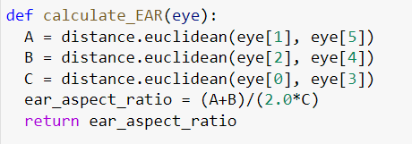
Euclidean Distance Calculation

Slide 14
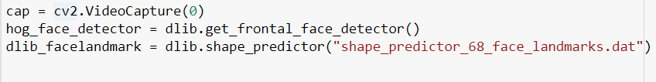
For Camera Capture And Face Detection

Slide 15
Demonstration...
Now we present a small video demonstration of our Project

Slide 16


Slide 17
Future Scope
This system can be further extended to have security like only certain people can access the vehicle ,In case of theft, the vehicle does not start and an mms of the burglar could be sent to the owner of the vehicle.
Such advanced systems can be used for a secure future, where the automobile has become an important transportation factor of our life and hope to minimize the accidental statistics in the future.

Slide 18
Presented By:-
Group : 2 Harsh Raj Singh
CSE-B(2) Suraj Kumar Sharma
6th Semester Sharuf Ali

